Slide 1
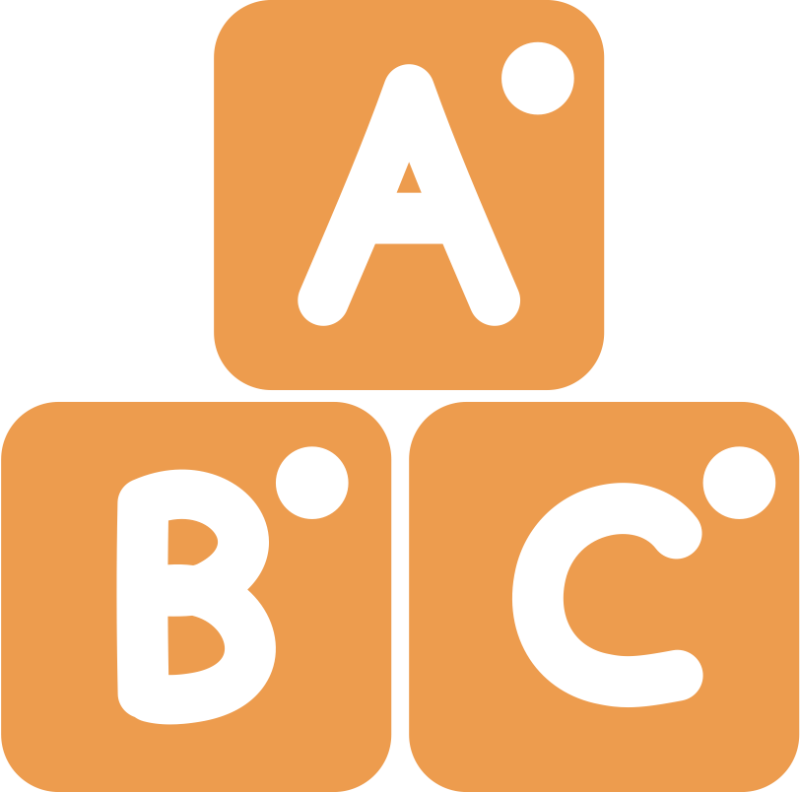
NYC PUBLIC SCHOOLS
LITERACY COLLABORATIVE
Digraph Sounds
An Interactive Activity for Children and their Families

Slide 2
DIRECTIONS
DIGRAPH SOUNDS
Sit with your child and click on the card and listen to the letter(s), keyword, and sound.
Repeat the letter(s), keyword, and sound for your child and ask them to repeat it after you.
Ask them, “what other words can you think of that have these digraphs?”

Slide 3
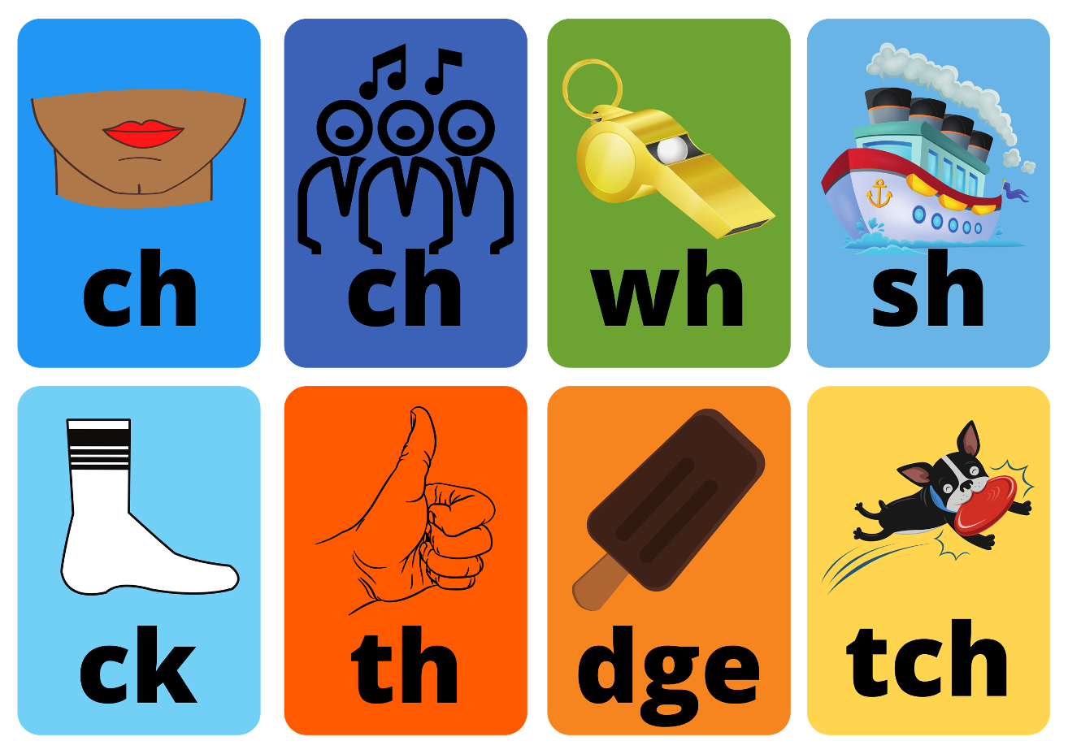
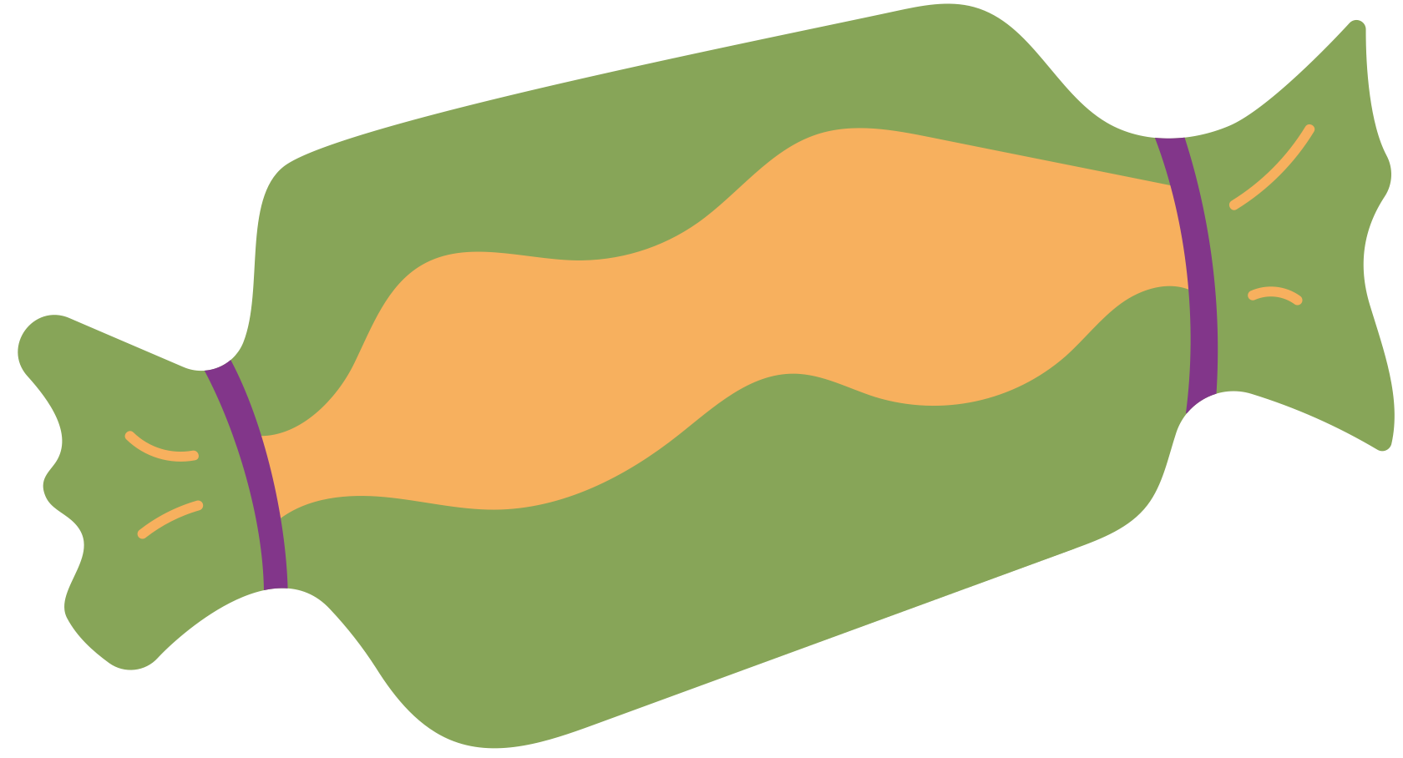

Slide 4
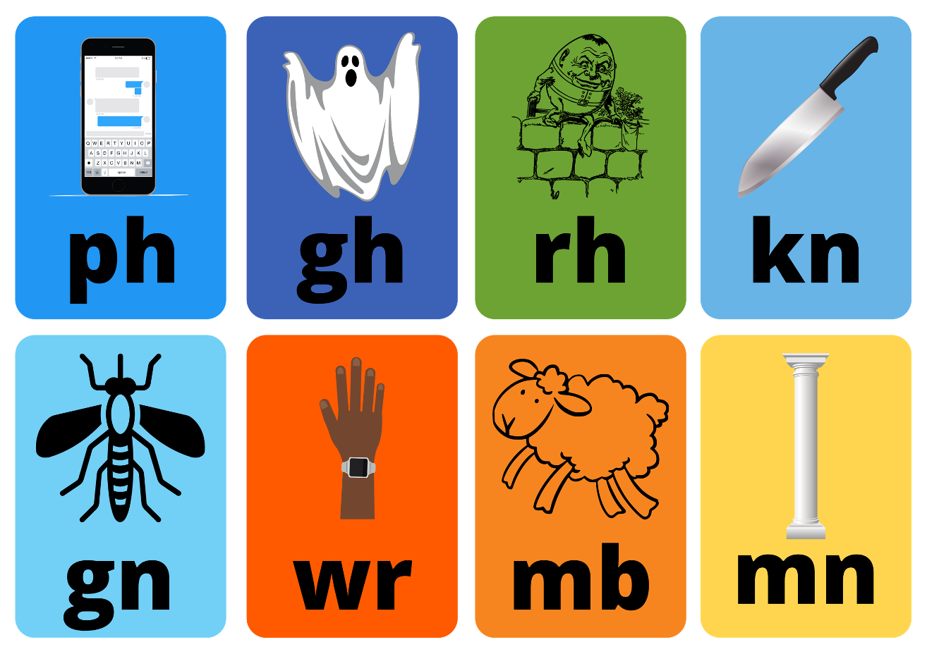

Slide 5
